Slide 1
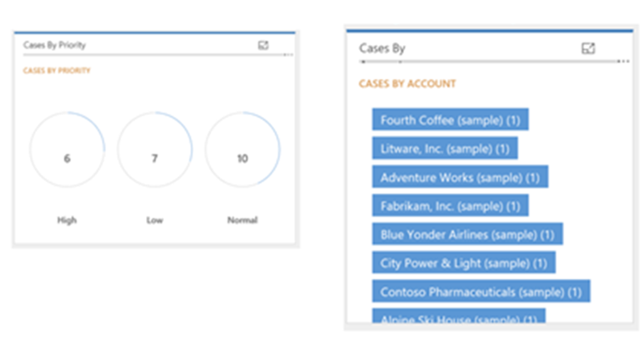
Donut Chart – Shows number of cases by priority
Tag Chart – List of cases by account

